Slide 1
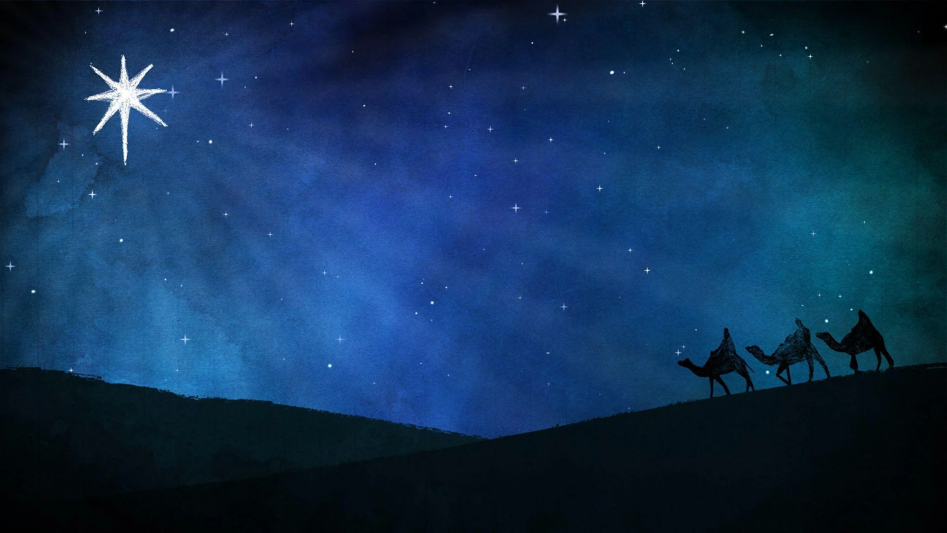
Why Celebrate Christmas?
John 1:1-2; 14-18
December 24, 2023

Slide 2
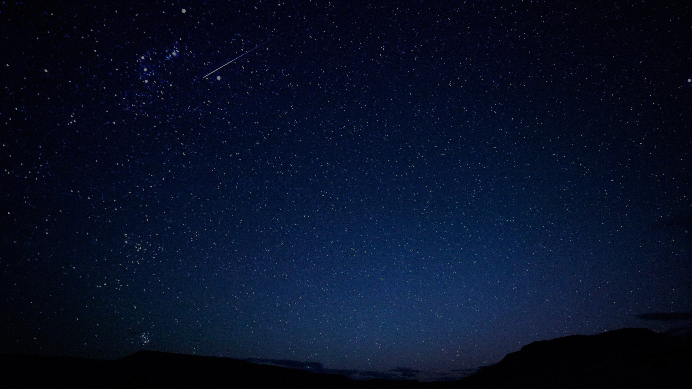
John 1:1-2; 14-18
1 In the beginning was the Word, and the Word was with God, and the Word was God. 2 He was in the beginning with God…14 And the Word became flesh, and dwelt among us, and we saw His glory, glory as of the only begotten from the Father, full of grace and truth. 15 John testified about Him and cried out, saying, "This was He of whom I said, 'He who comes after me has a higher rank than I, for He existed before me.'" 16 For of His fullness we have all received, and grace upon grace. 17 For the Law was given through Moses; grace and truth were realized through Jesus Christ. 18 No one has seen God at any time; the only begotten God who is in the bosom of the Father, He has explained Him.

Slide 3
The Big idea
Jesus came into the world to reveal and explain the glory of God to us!
Jesus reveals the glory of God perfectly (1:18)
Jesus reveals the glory of God in His person (1:1-3; 14)
Jesus reveals the glory of God in His preeminence (1:15)
Jesus reveals the glory of God in His presents (1:16-17)

Slide 4
Jesus Reveals the glory of God…
Perfectly ^{(1:18)}
No one has seen God at any time; the only begotten God who is in the bosom of the Father, He has explained Him.

Slide 5
Jesus Reveals the glory of God…
Perfectly ^{(1:18)}
In His person ^{(1:1-2; 14)}
1 In the beginning was the Word, and the Word was with God, and the Word was God. 2 He was in the beginning with God…14 And the Word became flesh, and dwelt among us, and we saw His glory, glory as of the only begotten from the Father, full of grace and truth.

Slide 6
Psalm 33:6; 9
6 By the word of the LORD the heavens were made, And by the breath of His mouth all their host. . .9 For he spoke, and it was done; he commanded, and it stood fast.

Slide 7
Hebrews 11:3
Through faith we understand that the worlds were prepared by the word of God, so that what is seen was not made out of things which are visible.

Slide 8
Hebrews 1:1-2
God, after He spoke long ago to the fathers in the prophets in many portions and in many ways, in these last days has spoken to us in His Son. . .".

Slide 9
John 1:1-2
1 In the beginning was the Word, and the Word was with God, and the Word was God. 2 He was in the beginning with God.

Slide 10
John 1:1-2
A paraphrase
At the very beginning of creation and time, the Word, as the perfect expression of God the Father, had already and always existed, and this Word was in active communion, face to face with God, and this Word inherently shared the same nature as God. He was already continuing in the beginning, face to face with God.

Slide 11
John 1:1-2; 14
1 In the beginning was the Word, and the Word was with God, and the Word was God. 2 He was in the beginning with God…
14 And the Word became flesh, and dwelt among us, and we saw His glory, glory as of the only begotten from the Father, full of grace and truth.

Slide 12
John 1:14:8-10
8 Philip said to Him, “Lord, show us the Father, and it is enough for us.” 9 Jesus said to him, “Have I been so long with you, and yet you have not come to know Me, Philip? He who has seen Me has seen the Father; how can you say, 'Show us the Father'? 10 Do you not believe that I am in the Father, and the Father is in Me? The words that I say to you I do not speak on My own initiative, but the Father abiding in Me does His works.”

Slide 13
Jesus Reveals the glory of God…
Perfectly ^{(1:18)}
In His person ^{(1:1-2; 14)}
In His preeminence ^{(1:15)}
John testified about Him and cried out, saying, ‘This was He of whom I said, He who comes after me has a higher rank than I, for He existed before Me.’

Slide 14
Jesus Reveals the glory of God…
Perfectly ^{(1:18)}
In His person ^{(1:1-2; 14)}
In His preeminence ^{(1:15)}
In His presents ^{(1:16-17)}
16 For of His fullness we have all received, and grace upon grace. 17 For the Law was given through Moses; grace and truth were realized through Jesus Christ.

Slide 15
John 17:4-5
4 I glorified You on the earth, having accomplished the work which You have given Me to do. 5 Now, Father, glorify Me together with Yourself, with the glory which I had with You before the world was.

Slide 16
Why celebrate Christmas?
Jesus came into the world to reveal and explain the glory of God to us!
Jesus reveals the glory of God perfectly (1:18)
Jesus reveals the glory of God in His person (1:1-3; 14)
Jesus reveals the glory of God in His preeminence (1:15)
Jesus reveals the glory of God in His presents (1:16-17)

Slide 17
Why Celebrate Christmas?
John 1:1-2; 14-18
December 24, 2023

